Slide 1
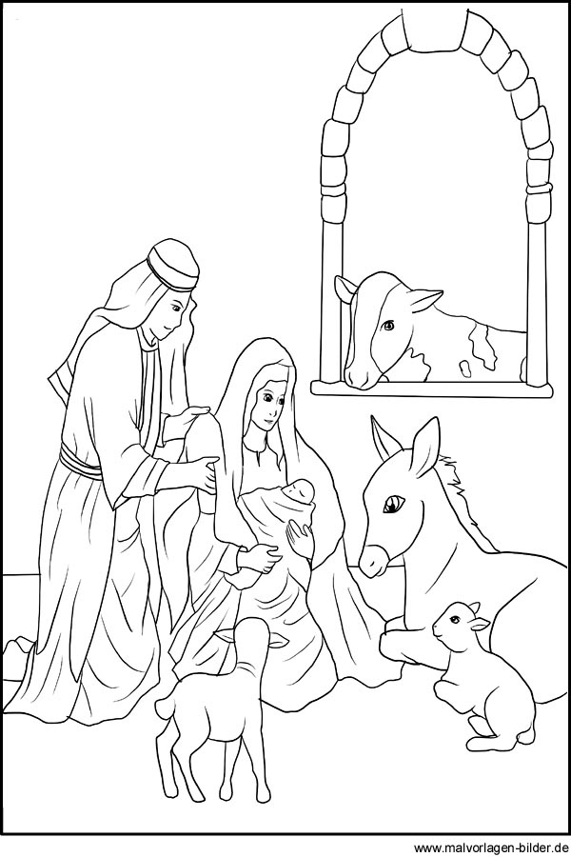
Merry Christmas
englisch

Slide 2
Jesus is born
Luke 1+2
His birth is prophesied
26 In the sixth month after Elizabeth had become pregnant, God sent the angel Gabriel to Nazareth, a town in Galilee.
27 He was sent to a virgin. The girl was engaged to a man named Joseph. He came from the family line of David. The virgin's name was Mary.
28 The angel greeted her and said, “The Lord has given you special favor. He is with you.”
29 Mary was very upset because of his words. She wondered what kind of greeting this could be.
30 But the angel said to her, “Do not be afraid, Mary. God is very pleased with you.
31 You will become pregnant and give birth to a son. You must name him Jesus.
32 He will be great and will be called the Son of the Most High God. The Lord God will make him a king like his father David of long ago.
33 He will rule forever over his people, who came from Jacob's family. His kingdom will never end.”
34 “How can this happen?” Mary asked the angel. “I am a virgin.”
35 The angel answered, “The Holy Spirit will come to you. The power of the Most High God will cover you. So the holy one that is born will be called the Son of God.
36 Your relative Elizabeth is old. And even she is going to have a child. People thought she could not have children. But she has been pregnant for six months now.
37 Nothing is impossible with God.”
38 “I serve the Lord,” Mary answered. “May it happen to me just as you said it would.” Then the angel left her.
englisch

Slide 3
Jesus is born
1 In those days, Caesar Augustus made a law. It required that a list be made of everyone in the whole Roman world.
2 It was the first time a list was made of the people while Quirinius was governor of Syria.
3 All went to their own towns to be listed.
4 So Joseph went also. He went from the town of Nazareth in Galilee to Judea. That is where Bethlehem, the town of David, was. Joseph went there because he belonged to the family line of David.
5 He went there with Mary to be listed. Mary was engaged to him. She was expecting a baby.
6 While Joseph and Mary were there, the time came for the child to be born.
7 She gave birth to her first baby. It was a boy. She wrapped him in large strips of cloth. Then she placed him in a manger. There was no room for them in the inn.
Shepherds and Angels
8 There were shepherds living out in the fields nearby. It was night, and they were looking after their sheep.
9 An angel of the Lord appeared to them. And the glory of the Lord shone around them. They were terrified.
10 But the angel said to them, “Do not be afraid. I bring you good news of great joy. It is for all the people.
11 Today in the town of David a Savior has been born to you. He is Christ the Lord.
12 Here is how you will know I am telling you the truth. You will find a baby wrapped in strips of cloth and lying in a manger.”
13 Suddenly a large group of angels from heaven also appeared. They were praising God. They said,
14 “May glory be given to God in the highest heaven! And may peace be given to those he is pleased with on earth!”
15 The angels left and went into heaven. Then the shepherds said to one another, “Let's go to Bethlehem. Let's see this thing that has happened, which the Lord has told us about.”
16 So they hurried off and found Mary and Joseph and the baby. The baby was lying in the manger.
17 After the shepherds had seen him, they told everyone. They reported what the angel had said about this child.
18 All who heard it were amazed at what the shepherds said to them.
19 But Mary kept all these things like a secret treasure in her heart. She thought about them over and over.
20 The shepherds returned. They gave glory and praise to God. Everything they had seen and heard was just as they had been told.
englisch

